Slide 1
Angicart: A software tool for extracting vascular networks and vessel measurements for 3D angiographic images
Elif Tekin
Van Savage’s lab

Slide 2
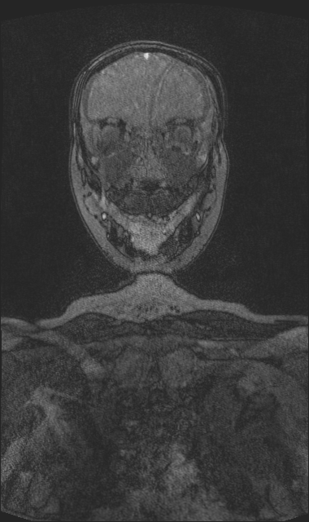
Purpose
Get data from vascular images
Why?
Better understand the vascular structure
Testing current theories on vascular systems
Learn more about blood flow
Tumor development and structure- drug delivery to tumors

Slide 3
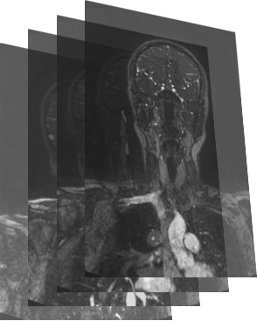
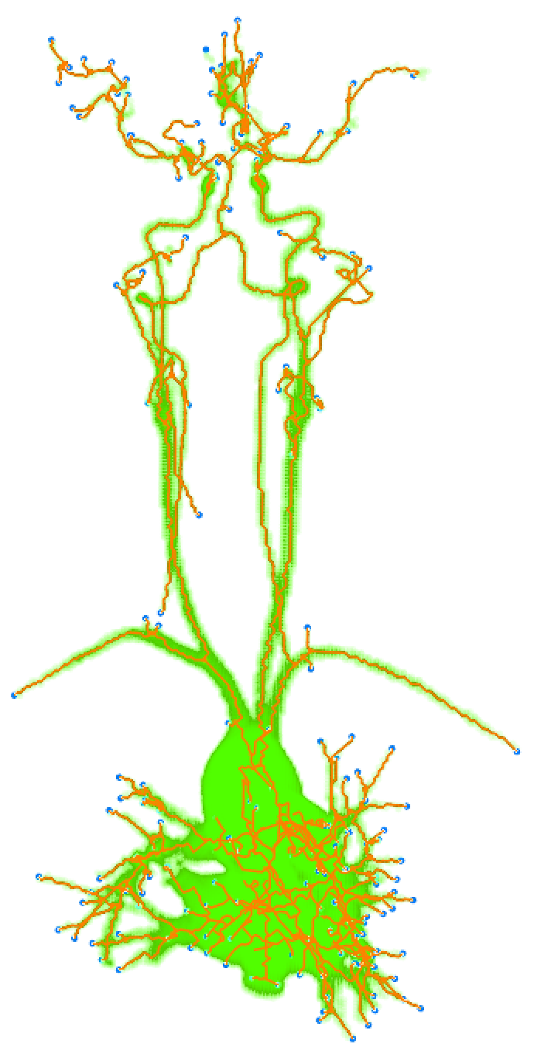
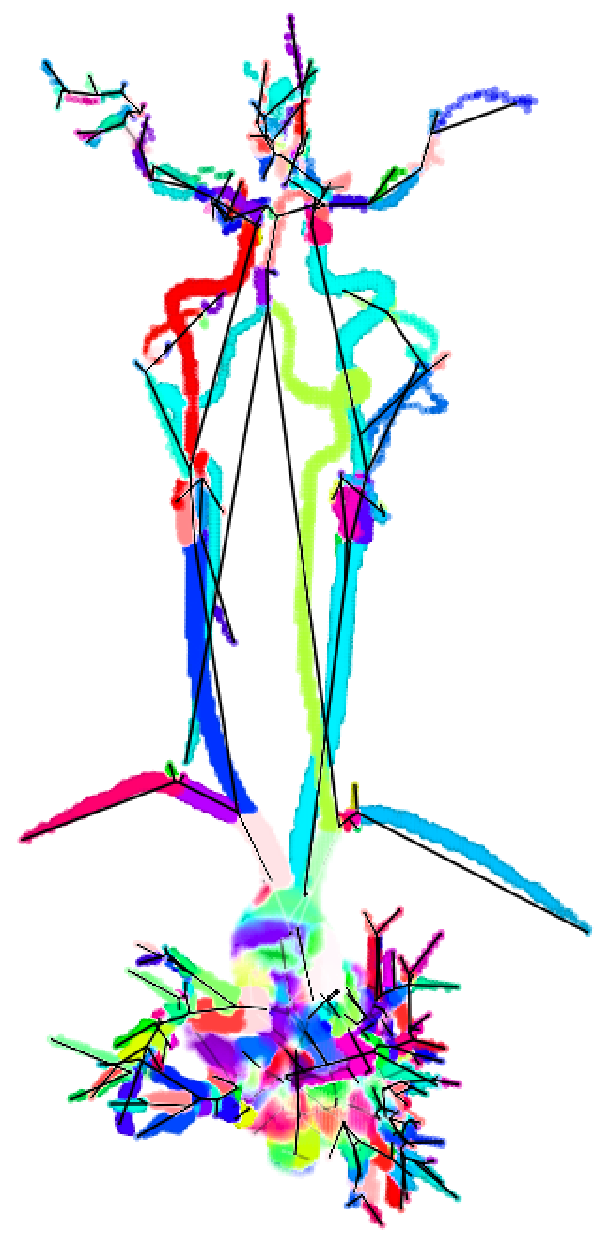
How it works?
Starts by classifying voxels belonging to vessels by a manual binary search to select the threshold value for intensity.
skeletonization via
erosion algorithm
segmentation
from skeletonization
input images
Newberry MG, Ennis DB, Savage VM (2015) "Testing Foundations of Biological Scaling Theory Using Automated Measurements of Vascular Networks." PLoS Comput Biol 11(8): e1004455. doi:10.1371/journal.pcbi.1004455

Slide 4
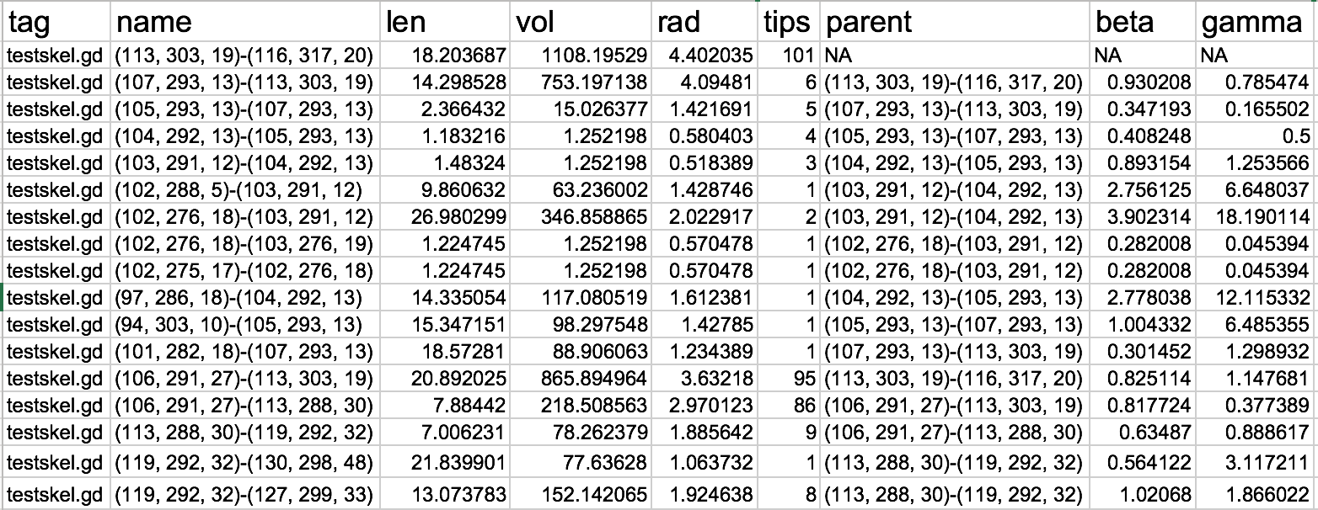
How it works?
Starts by classifying voxels belonging to vessels by a manual binary search to select the threshold value for intensity.
input images
output file describing the segments
Newberry MG, Ennis DB, Savage VM (2015) "Testing Foundations of Biological Scaling Theory Using Automated Measurements of Vascular Networks." PLoS Comput Biol 11(8): e1004455. doi:10.1371/journal.pcbi.1004455

Slide 5





Is it free?
Yes ☺ It is free and always will be
Is it easy to install and use?
Angicart is written in Ocaml
Is it possible to get help?
Of course!

Slide 6
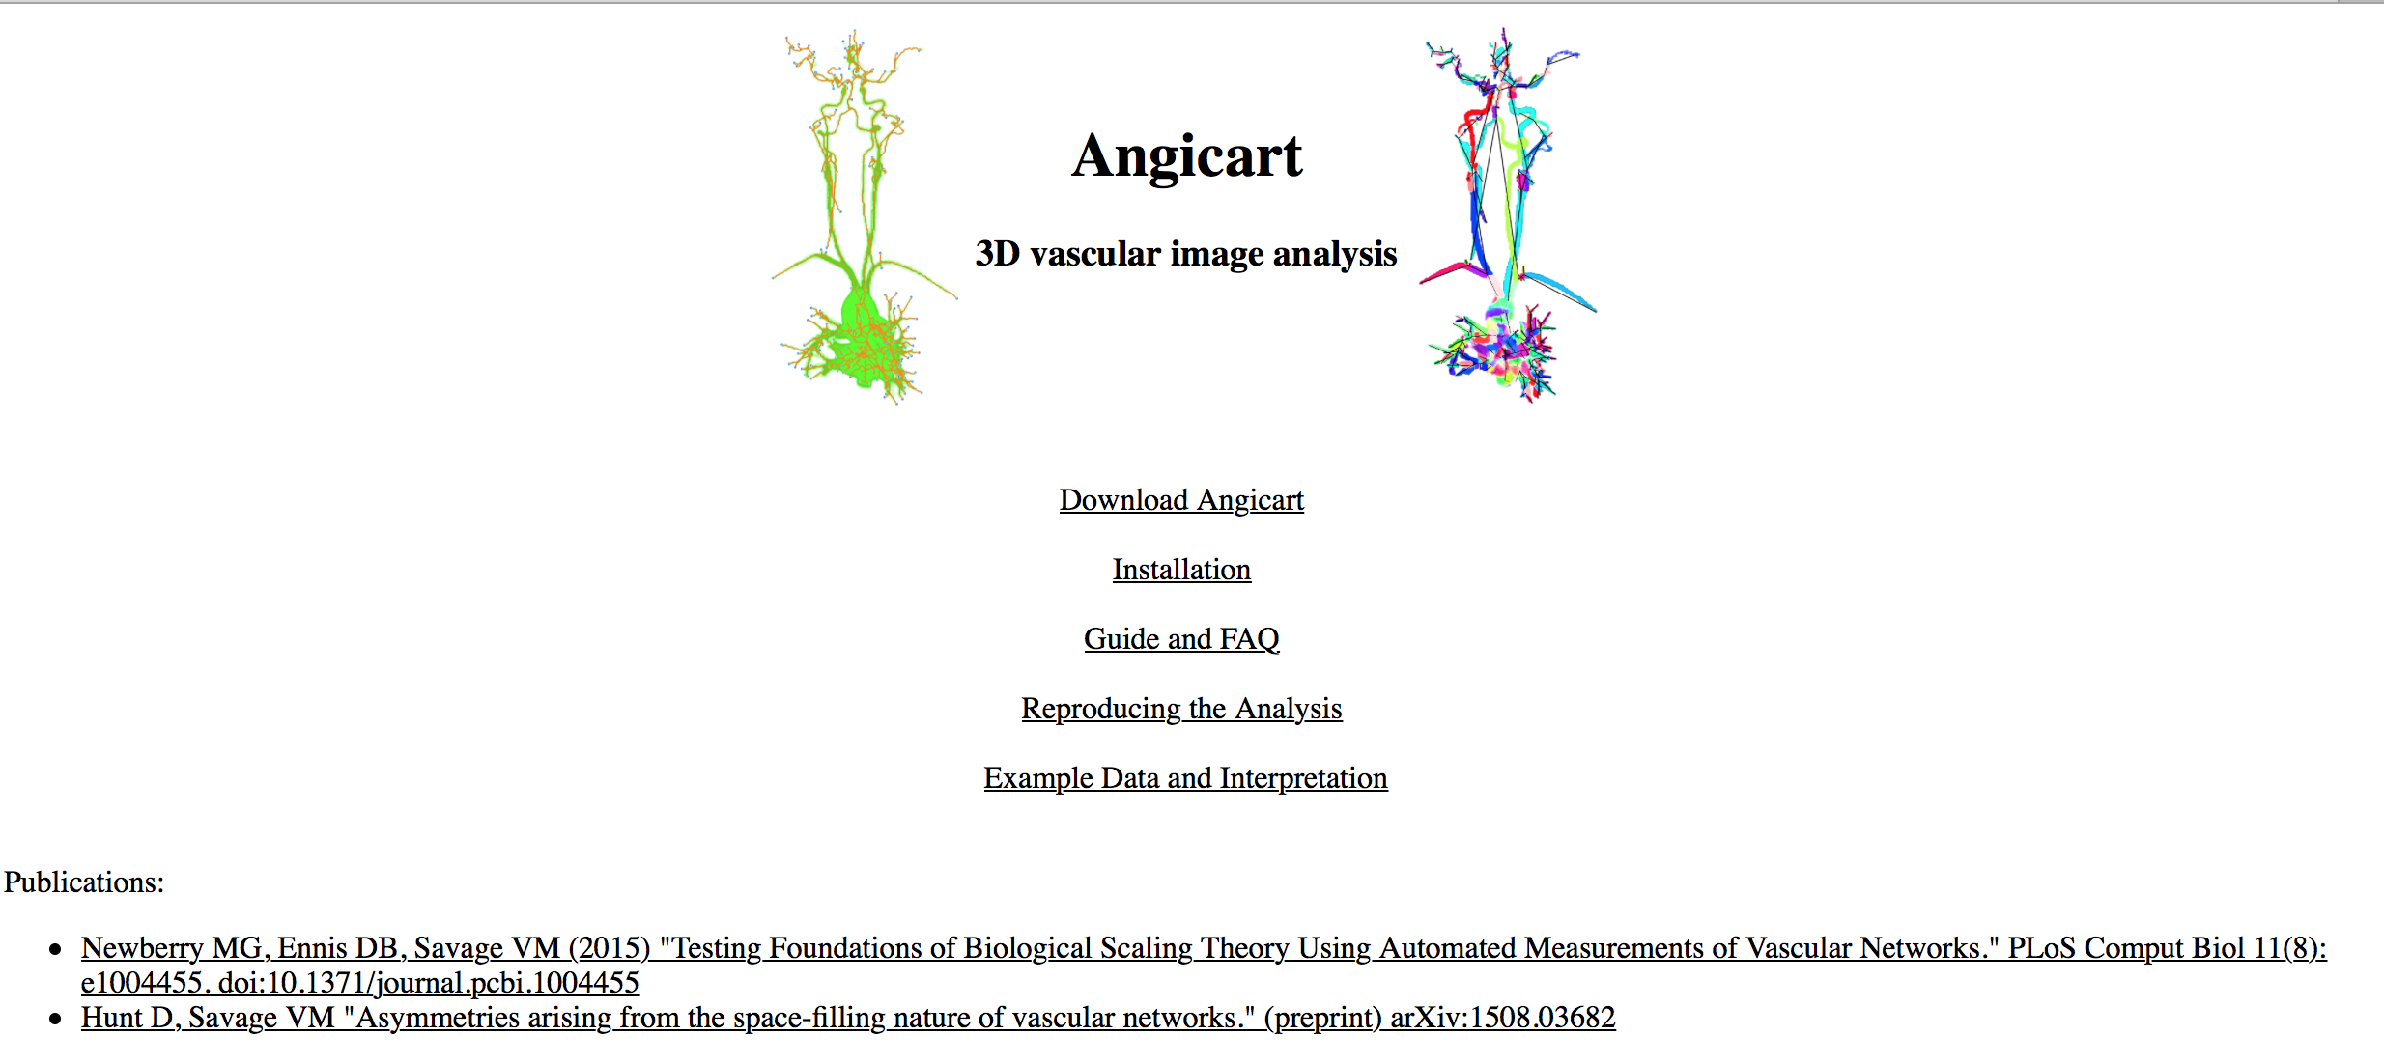
Website http://faculty.biomath.ucla.edu/vsavage/indexangic.html

Slide 7
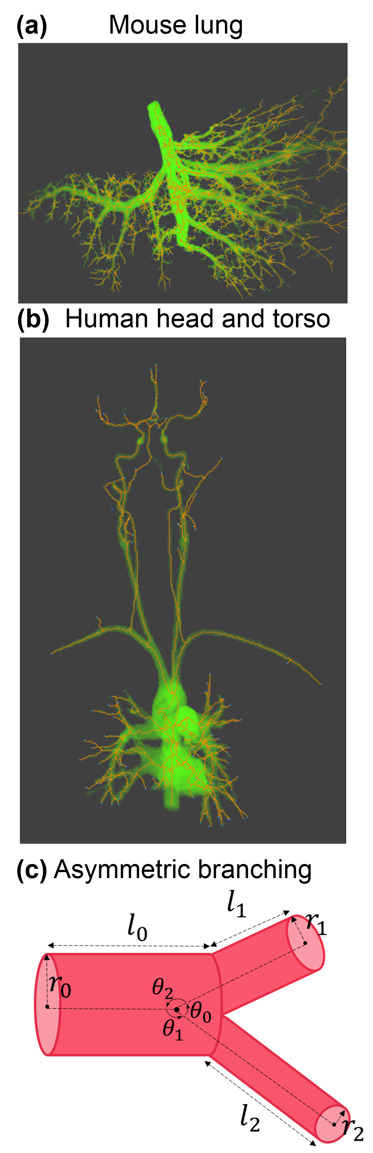
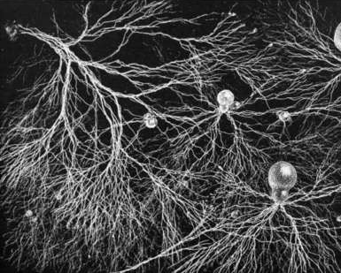
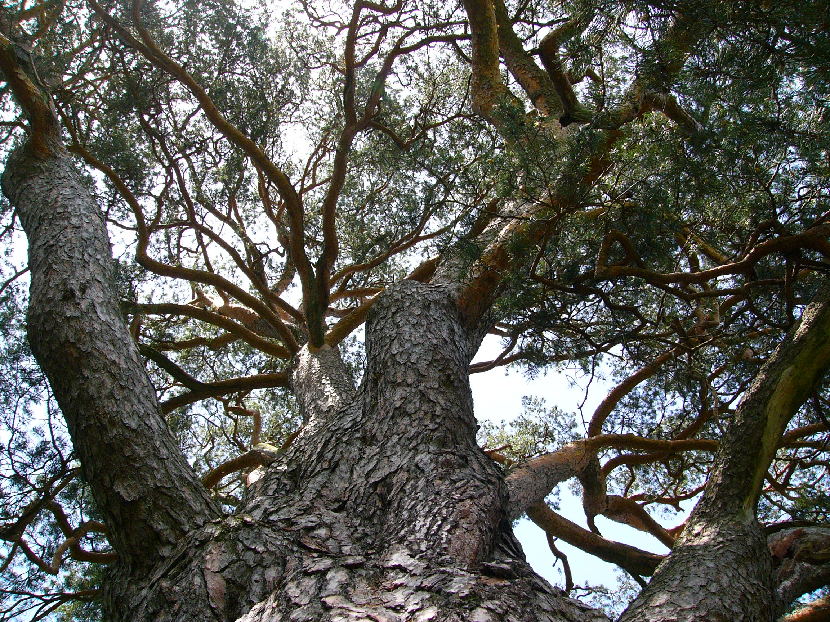
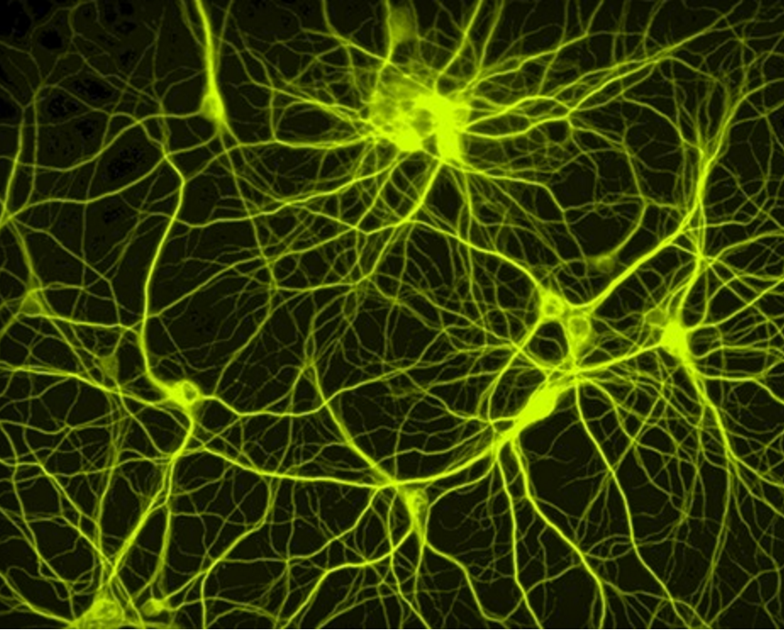
What can you process via Angicart ?
animal vascular system
fungi network
plant vascular network
neural network
https://sharon-taxonomy2010-p2.wikispaces.com/FungiWide range of applications
http://www.extremetech.com/extreme/179223-the-first-real-time-non-invasive-imaging-of-neurons-forming-a-neural-network

Slide 8
Any advances on the recent version?
Original Angicart code is for tree-like structures. So it does not recognize the loops.
Angicart is written in Ocaml.
Recent work in translating Angicart to C++ by building an extra piece to identify loops.
Important for stroke recovery, plant leaves, neurons, etc.

Slide 9
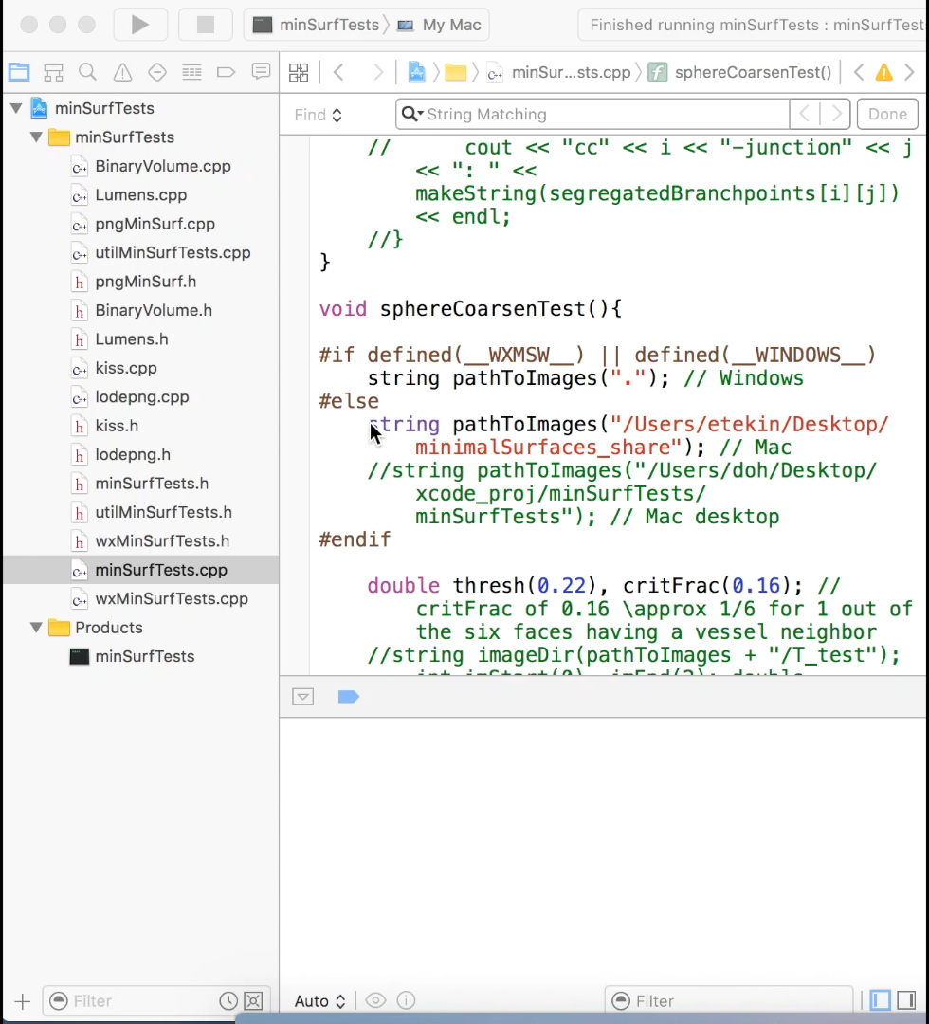
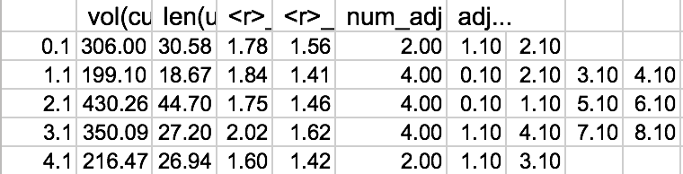
Early version of Angicart in C++ is tested with 3D toy network
Can handle loops.
Provides topological data and the physical properties of each segment

Slide 10
What we did with Angicart?
Data from Kristina Bostrom’s lab
Data from Daniel Ennis’s lab
Tekin E., Newberry MG, Savage VM. 2016 Do vascular networks branch optimally or randomly across spatial scales? . in review.

Slide 11
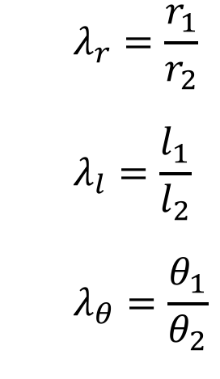
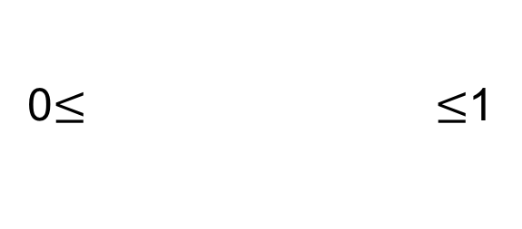
What we did with Angicart?
$$λ_{r}=\frac{r_{1}}{r_{2}}$$
$$λ_{l}=\frac{l_{1}}{l_{2}}$$
$$λ_{θ}=\frac{θ_{1}}{θ_{2}}$$
Smaller quantity
0$≤ ≤$1
Larger quantity
Tekin E., Newberry MG, Savage VM. 2016 Do vascular networks branch optimally or randomly across spatial scales? . in review.

Slide 12
What we did with Angicart?
$$λ_{r}=\frac{r_{1}}{r_{2}}$$
$$λ_{l}=\frac{l_{1}}{l_{2}}$$
$$λ_{θ}=\frac{θ_{1}}{θ_{2}}$$
Smaller quantity
0$≤ ≤$1
Larger quantity
Perfect
Asymmetry
Perfect
Symmetry
Tekin E., Newberry MG, Savage VM. 2016 Do vascular networks branch optimally or randomly across spatial scales? . in review.

Slide 13
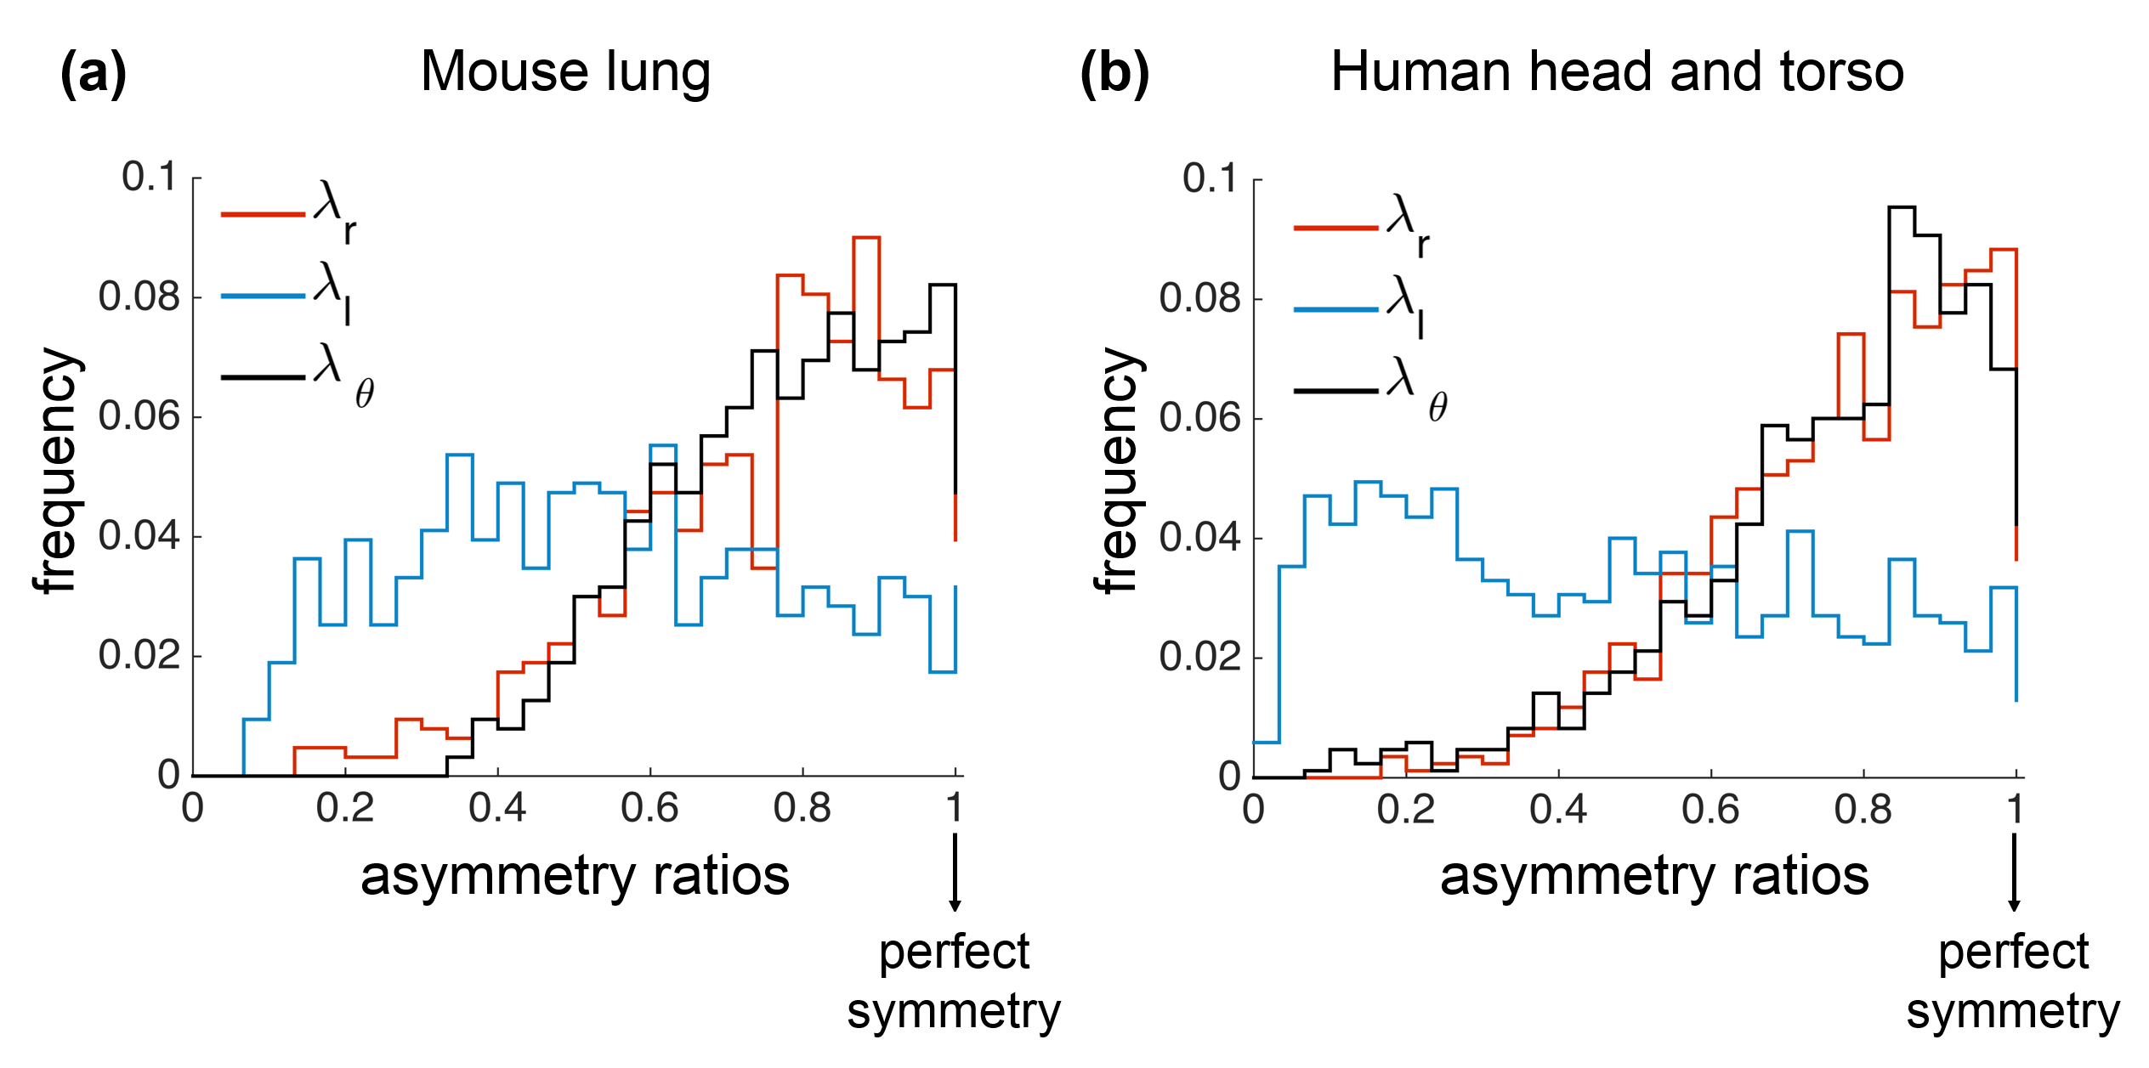
Results
Systematic asymmetry patterns
Hunt D, Savage VM "Asymmetries arising from the space-filling nature of vascular networks." (preprint) arXiv:1508.03682
Tekin E., Newberry MG, Savage VM. 2016 Do vascular networks branch optimally or randomly across spatial scales? . in review.

Slide 14
Q: How these systematic branching patterns emerge?
Hypotheses
Selection and development influence
minimization of the cost of materials
distributing the flow efficiently
or
(2) Vascular geometry is influenced by stochastic events
develop optimization functions locally,
find solutions
compare with empirical data
Randomly placed branching junctions by constraining the vascularity across different spatial scales
Tekin E., Newberry MG, Savage VM. 2016 Do vascular networks branch optimally or randomly across spatial scales? . in review.

Slide 15
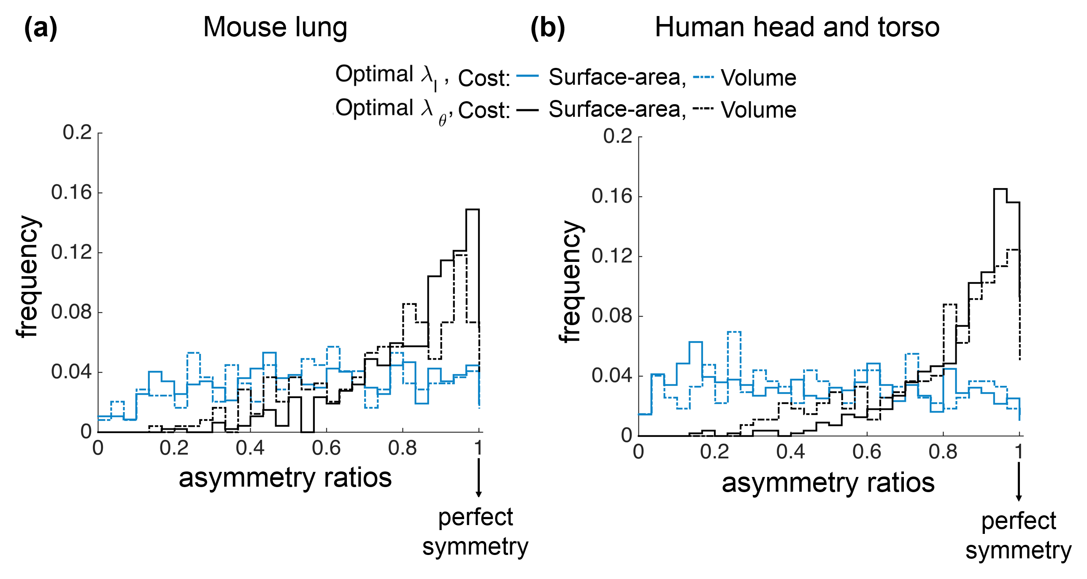
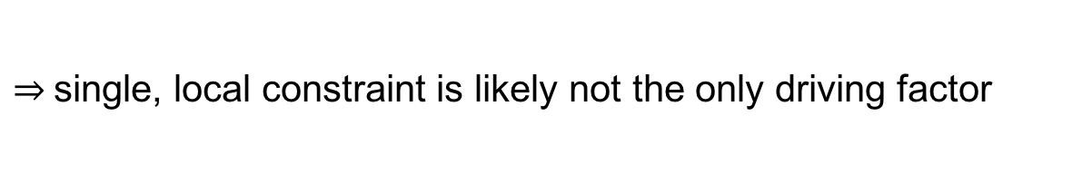
Optimal Branching Hypothesis (Local)
Match the patterns at the network-level
However, we don’t get good match at the junction-level comparison
$⇒$single, local constraint is likely not the only driving factor
Tekin E., Newberry MG, Savage VM. 2016 Do vascular networks branch optimally or randomly across spatial scales? . in review.

Slide 16
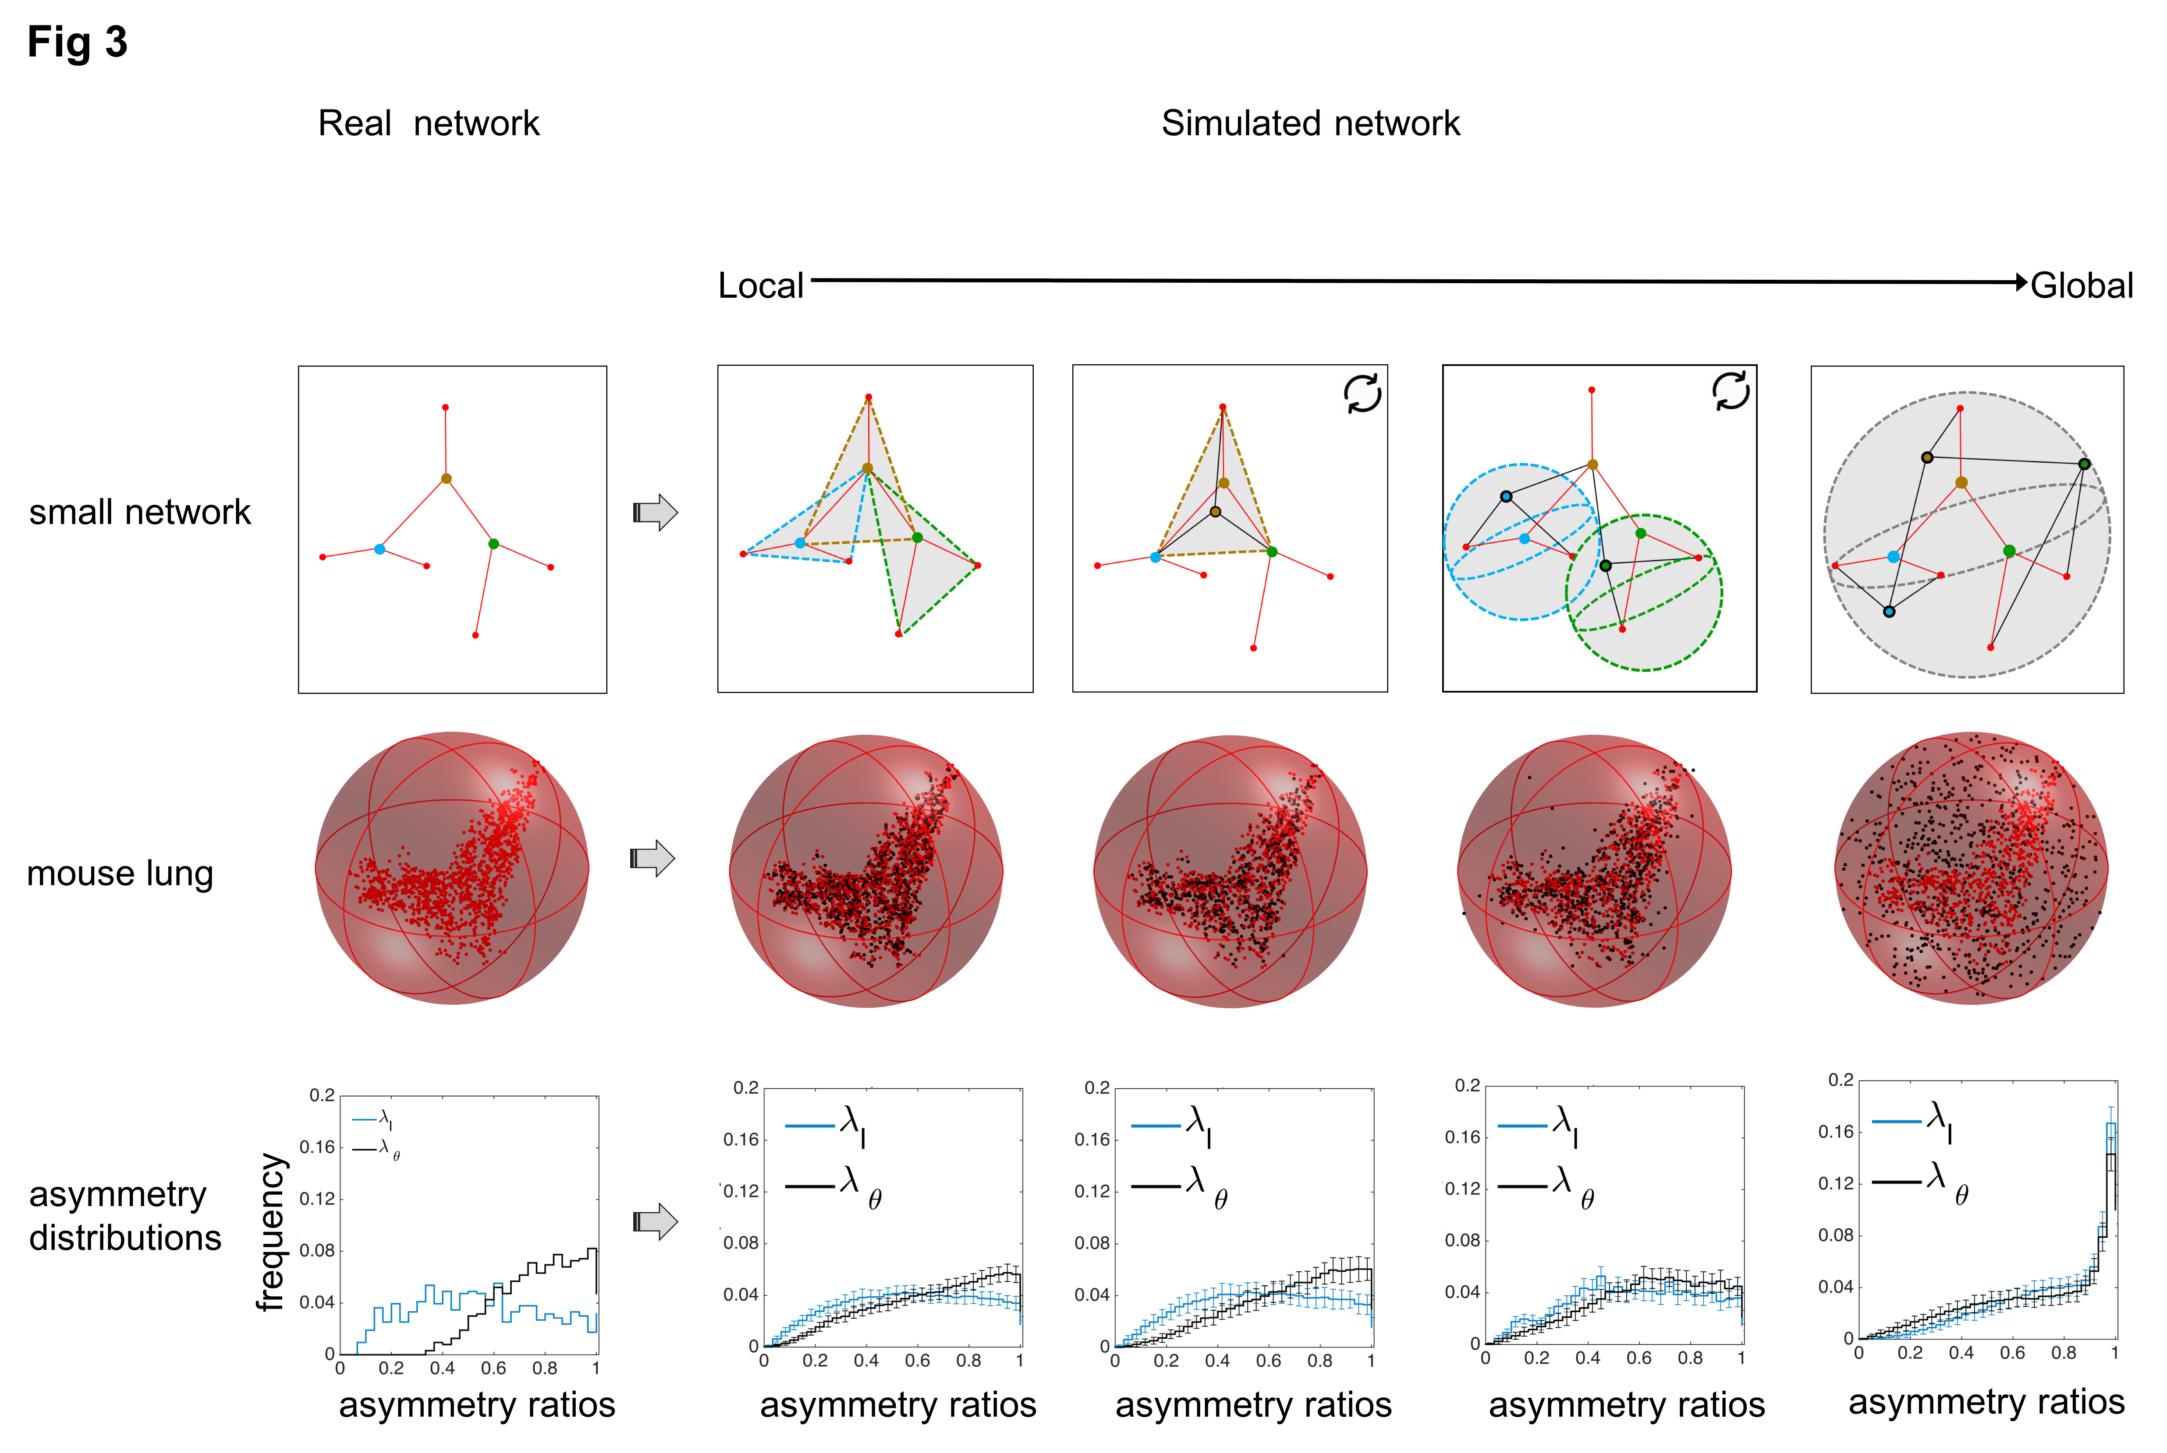
Random Branching Hypothesis
Tekin E., Newberry MG, Savage VM. 2016 Do vascular networks branch optimally or randomly across spatial scales? . in review.

Slide 17
Conclusions/ Take home points
By combining modeling perspective with the empirical data
We find systematic patterns of asymmetry in vascular branching.
We argue that local-scale optimization principles and constraints are insufficient to understand and predict asymmetric branching patterns.
We find that material-cost optimizations are the strongest predictor of vascular branching in the human head and torso, whereas locally or intermediately constrained random branching is comparable to material-cost optimizations for the mouse lung.

Slide 18
Conclusions/ Take home points
In order to better understand vascular system, test our theoretical predictions, we need high quality data.
Angicart offers an easy and efficient extraction of vascular data from angiographic images.
New version of Angicart in C++ recognizes loops- full version will be available soon.

Slide 19
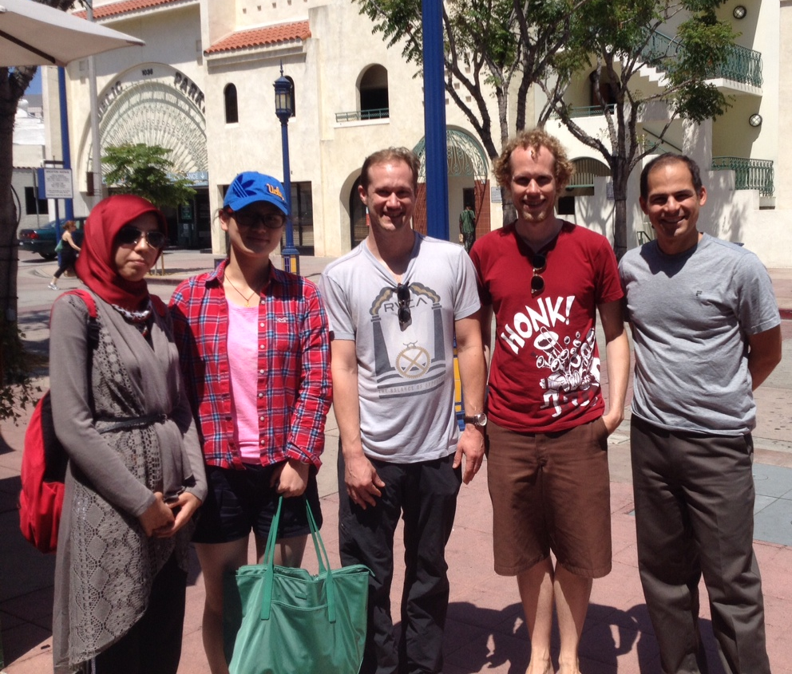

Acknowledgements
&
Prof. Kristina Bostrom
Prof. Daniel Ennis

